Slide 1
AGENT-BASED MODELLING AND REINFORCEMENT LEARNING FOR ROUTE SCHEDULING: INTEGRATING OPEN SOURCE SOFTWARE
PhDc, Valentas Gružauskas

Slide 2
Valentas Gružauskas
Independent Business Owner
Expanding a business system with Internet Service Corporation, Yager Group
PhD Student
Kaunas University of Technology, PhD in management science from 2016
Freelance Data Science
Statistical analysis, visualization, automation and machine learning approaches

Slide 3
INTRODUCTION TO AGENT-BASED MODELLING

Slide 4
Agent based modelling
An agent-based model (ABM) is a class of computational models for simulating the actions and interactions of autonomous agents (both individual or collective entities such as organizations or groups) with a view to assessing their effects on the system as a whole
Define first principle rules of agents to analyse individual intersection outcome at a macro level

Slide 5
Components of agent based modeling
Environment
Abstract vs GIS, Static vs Dynamic
Agents
Person, organization, animal, bacteria, etc.
Relationships
Decision rules between agents, individual tasks

Slide 6
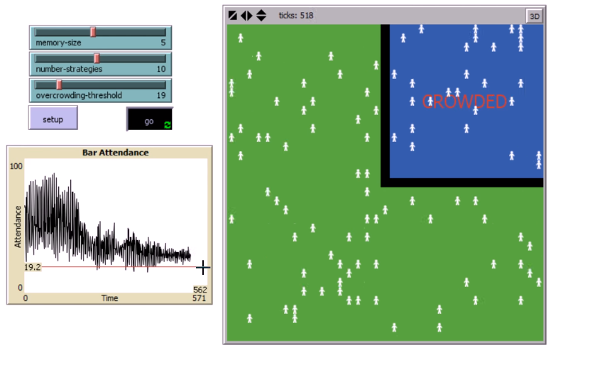
El Farol Bar Problem
The city wants to go to the el Farol bar, however the bar is very small.
If less than 60% of the population go to the bar, they'll all have a better time than if they stayed at home.
If more than 60% of the population go to the bar, they'll all have a worse time than if they stayed at home.
How you should decide when to go to the bar?

Slide 7
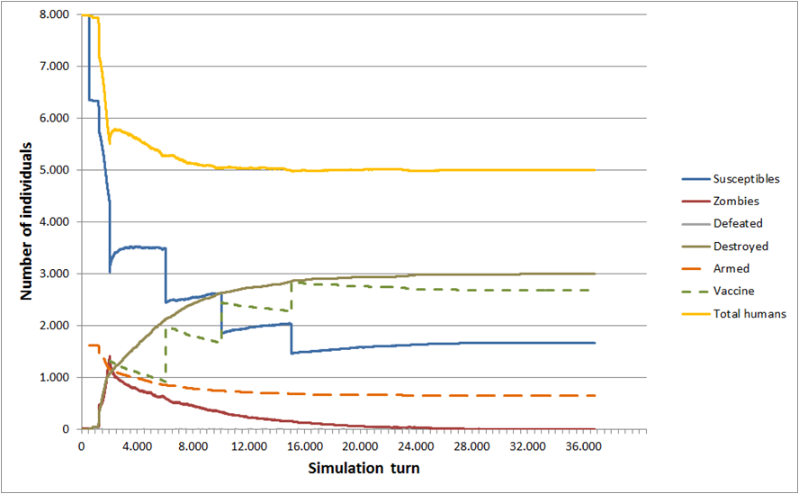
Disease infection models (Zombie apocalypse)

Slide 8
URBAN LOGISTICS SIMULATION

Slide 9
Urban logistics case
Euromonitor international reports that the world internet retailing market size in 2016 was 1.17 trillion USD and by 2020 it is estimated to grow to a size of 2.1 trillion with a AAGR of 13.33%
The world’s population is expected to reach 9 billion by 2050
The "last mile problem“: Last leg of the supply chain is least efficient, comprising up to 28% of the total logistics cost
Urbanization will continue at an accelerated pace, and about 70 percent of the world’s population will be urban, compared to 49 percent today

Slide 10
PROBLEM
When delivering food products to end-consumers (e-grocery) the products are sensitive to shelf life.
Which is lost if orders are not delivered on time due to traffic accidents and congestions.
GOAL
What is the influence of traffic accidents and congestions to food quality?
How to improve food quality by using the same assets (e.g. warehousing space and trucks)?

Slide 11
Structure of simulation

Slide 12
AGENT-BASED MODEL ENVIROMENT

Slide 13
Market demand
The data has been gathered from 5 companies, which are involved in the food industry. The companies shared their daily sales history from June of 2014 until June of 2017, which consisted of total 7 product categories and 838 products.
Product category | Distribution | Coefficient 1 | Coefficient 2
Frozen products | Pareto | 8.02 | 10.83
Flour products | Log logistics | 0.53 | 1.03
Ice products | Burr | 0.84 | 2.11
Meat products | Burr | 0.89 | 1.81
Milk products | Pareto | 8.02 | 10.83
Pasta products | Log logistics | 0.56 | 0.99
Spices | Log normal | 0.56 | 0.99

Slide 14
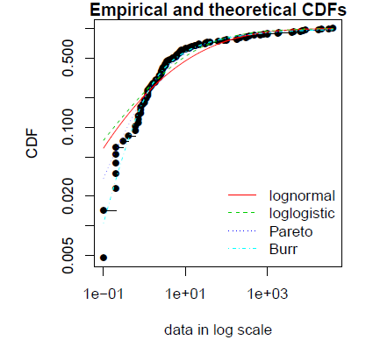
Distribution fitting
The package fitdistrplus provides functions for fitting univariate distributions to different types of data and allowing different estimation methods (maximum likelihood, moment matching, quantile matching and maximum goodness-of-fit estimation).
Source: Delignette-Muller, M. L., & Dutang, C. (2015). fitdistrplus: An R package for fitting distributions. Journal of Statistical Software, 64(4), 1-34.

Slide 15
Traffic accidents
Cluster ID | Traffic accident | Vehicles involved | Probability per conjunction | Reduction to speed | Accident duration (min)
0 | Low | Less than 4 | 0.000628 | 15% | 60
1 | Low | Less than 4 | 0.000596 | 15% | 60
2 | High | Less than 4 | 0.000008 | 70% | 150
2 | Medium | Less than 4 | 0.000128 | 30% | 90
3 | High | More than 4 | 0.000004 | 85% | 180
3 | Medium | More than 4 | 0.000006 | 65% | 120
3 | Low | More than 4 | 0.000046 | 30% | 90
The traffic flow are used from traffic grid model, which is included in Netlogo (Wilensky 2003).
Traffic accident levels are derived from UK traffic accident statistics (Department of transport 2017).

Slide 16
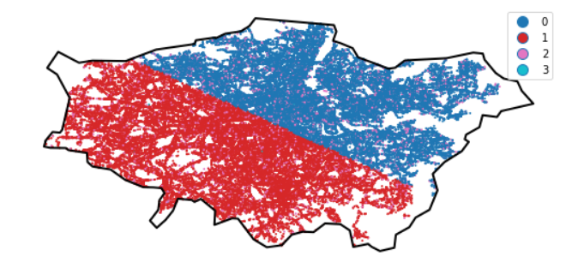
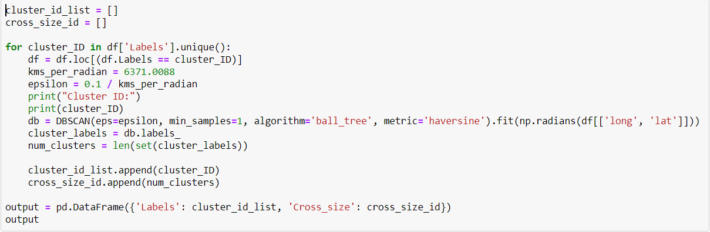
London traffic accident clusters
Module: sklearn, geopandas
Density-based spatial clustering of applications with noise (DBSCAN)

Slide 17
AGENTS

Slide 18
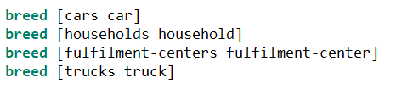
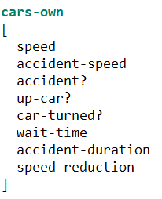
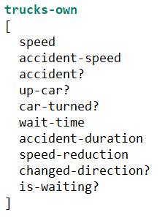
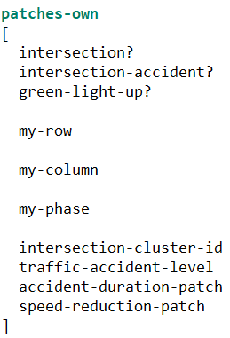
Agents
Turtles:
Cars
Household
Warehouse
Trucks
Patches:
Traffic lights
Intersections

Slide 19
INTERACTION OF AGENTS

Slide 20
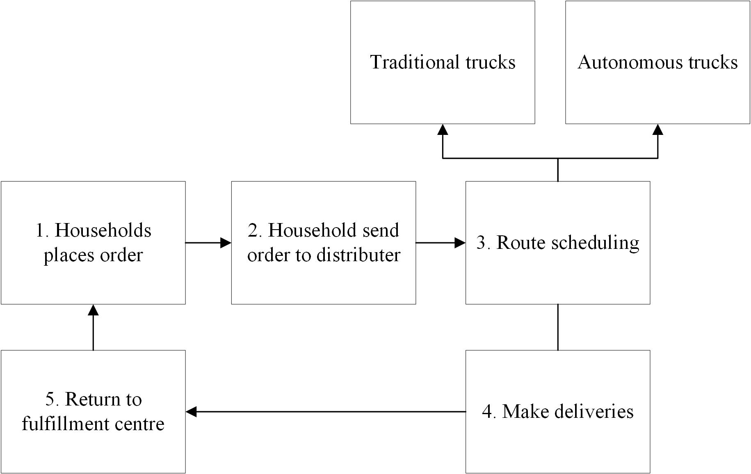
The process of the model

Slide 21
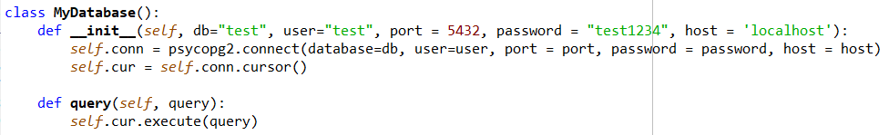
Database (PostgreSQL, module: psycopg2)
Inventory list
Truck schedule
Actual and planned schedule results
Planned map with locations & speed
Etc.

Slide 22
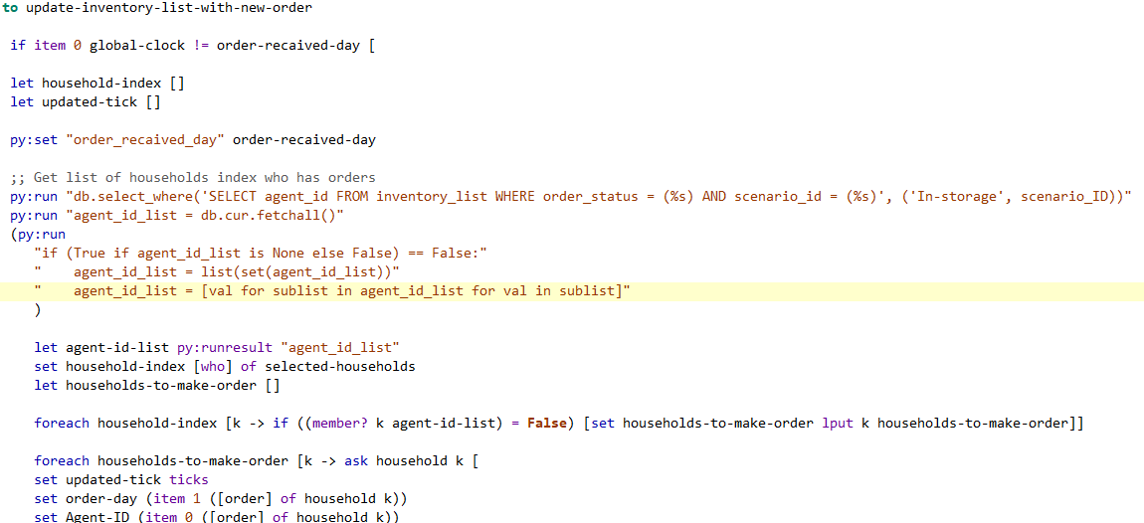
Household orders
household-make-order:
Select time window
Demand

Slide 23
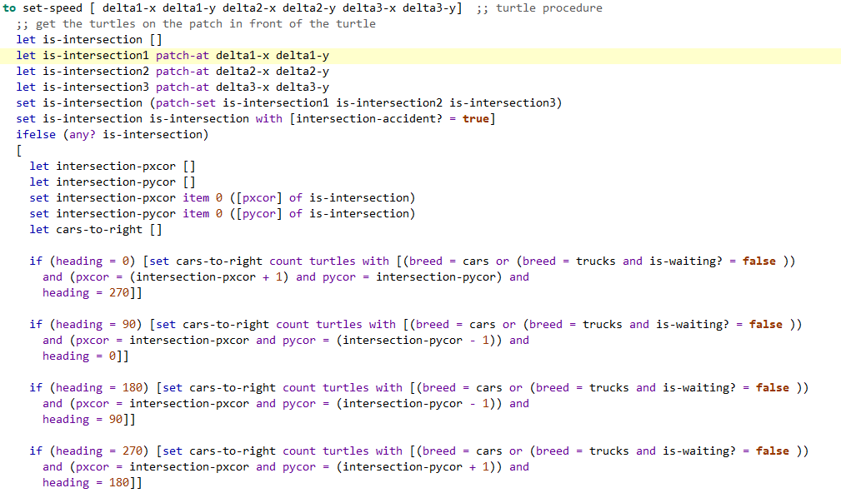
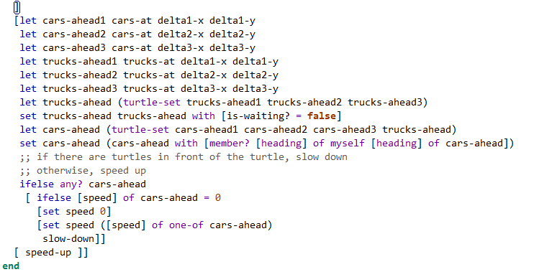
Car movement

Slide 24
Traditional routing (matlab & Java)
Generate historical speed from Netlogo
Generate map from road, household and warehouse location from Netlogo;
Create interpolation matrix of historical speed variation by time
Create graph from between locations (A* search)

Slide 25
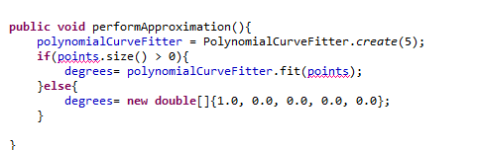
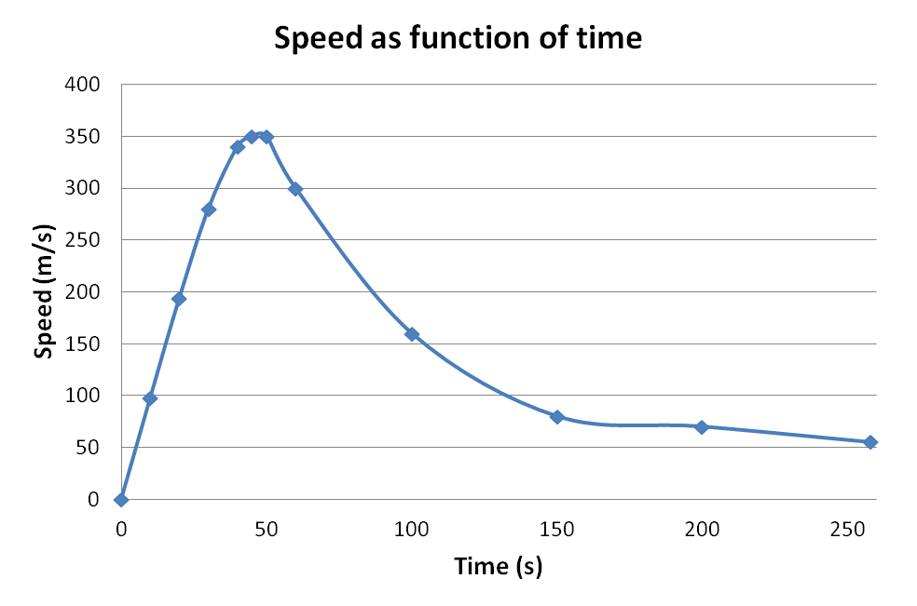
Approximation (Java)
A function approximation problem asks us to select a function among a well-defined class that closely matches ("approximates") a target function in a task-specific way.
Python module:
Scipy, interpolate

Slide 26
Vehicle routing problem with time windows and capacity constraints
Graph with household and warehouse locations (Matrix size: 400 x 400);
Each matrix value is an interpolated function represeting speed variation per time;
Simulated annealing is used to create a schedule for truck based on capacity and order time window.

Slide 27
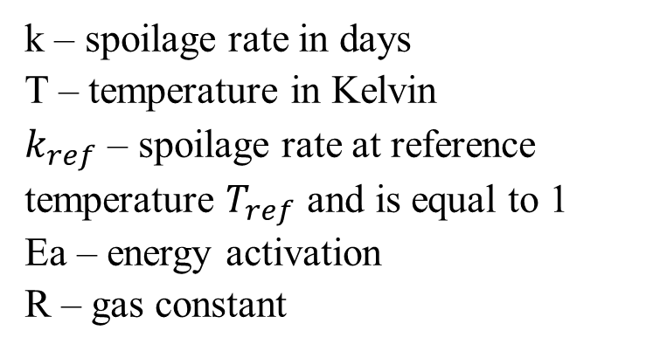
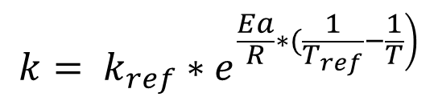
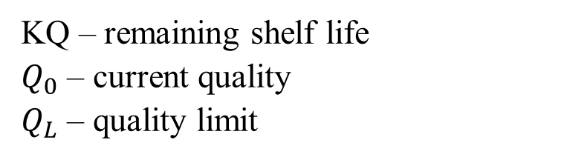
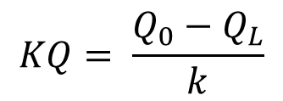
Food quality (goal function)
k – spoilage rate in days
T – temperature in Kelvin
$k_{ref}$ – spoilage rate at reference temperature $T_{ref}$ and is equal to 1
Ea – energy activation
R – gas constant
$$k= k_{ref}∗e^{\left.\frac{Ea}{R}∗(\frac{1}{T_{ref}}−\frac{1}{T}\right)}$$
KQ – remaining shelf life
$Q_{0}$ – current quality
$Q_{L}$ – quality limit
$$KQ= \frac{Q_{0}−Q_{L}}{k}$$
Source: Fikar, C. (2018). A decision support system to investigate food losses in e-grocery deliveries. Computers & Industrial Engineering, 117, 282-290.

Slide 28
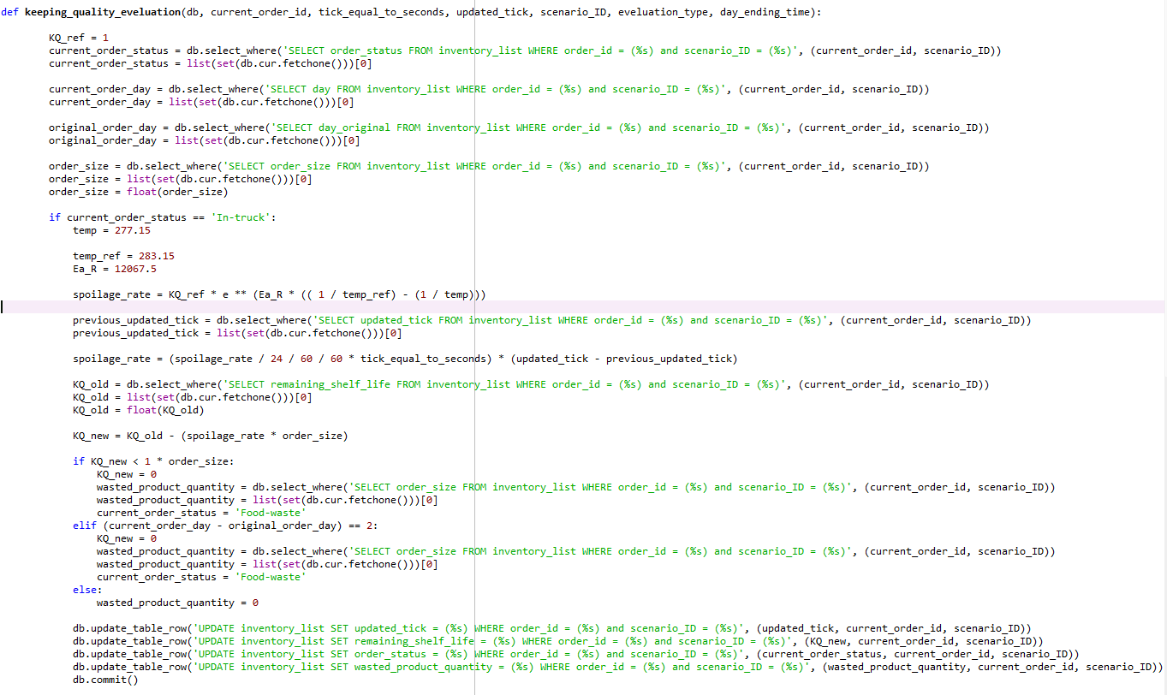
Food quality measurement (Python)

Slide 29
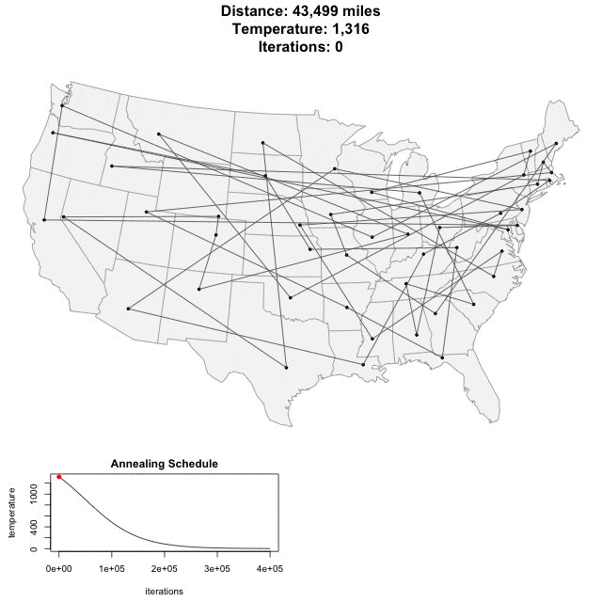
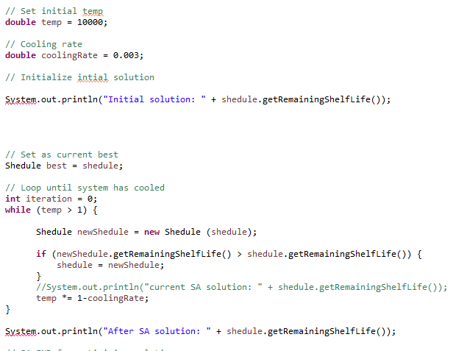
Simulated annealing (Java)
Python module: Scipy, Optimize.Anneal

Slide 30
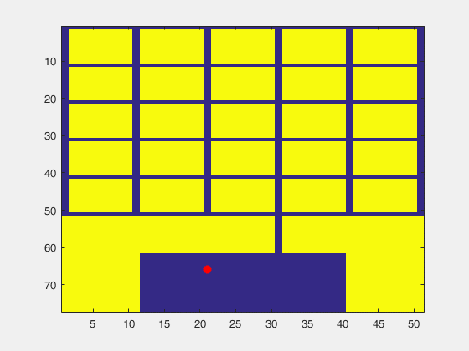

Slide 31
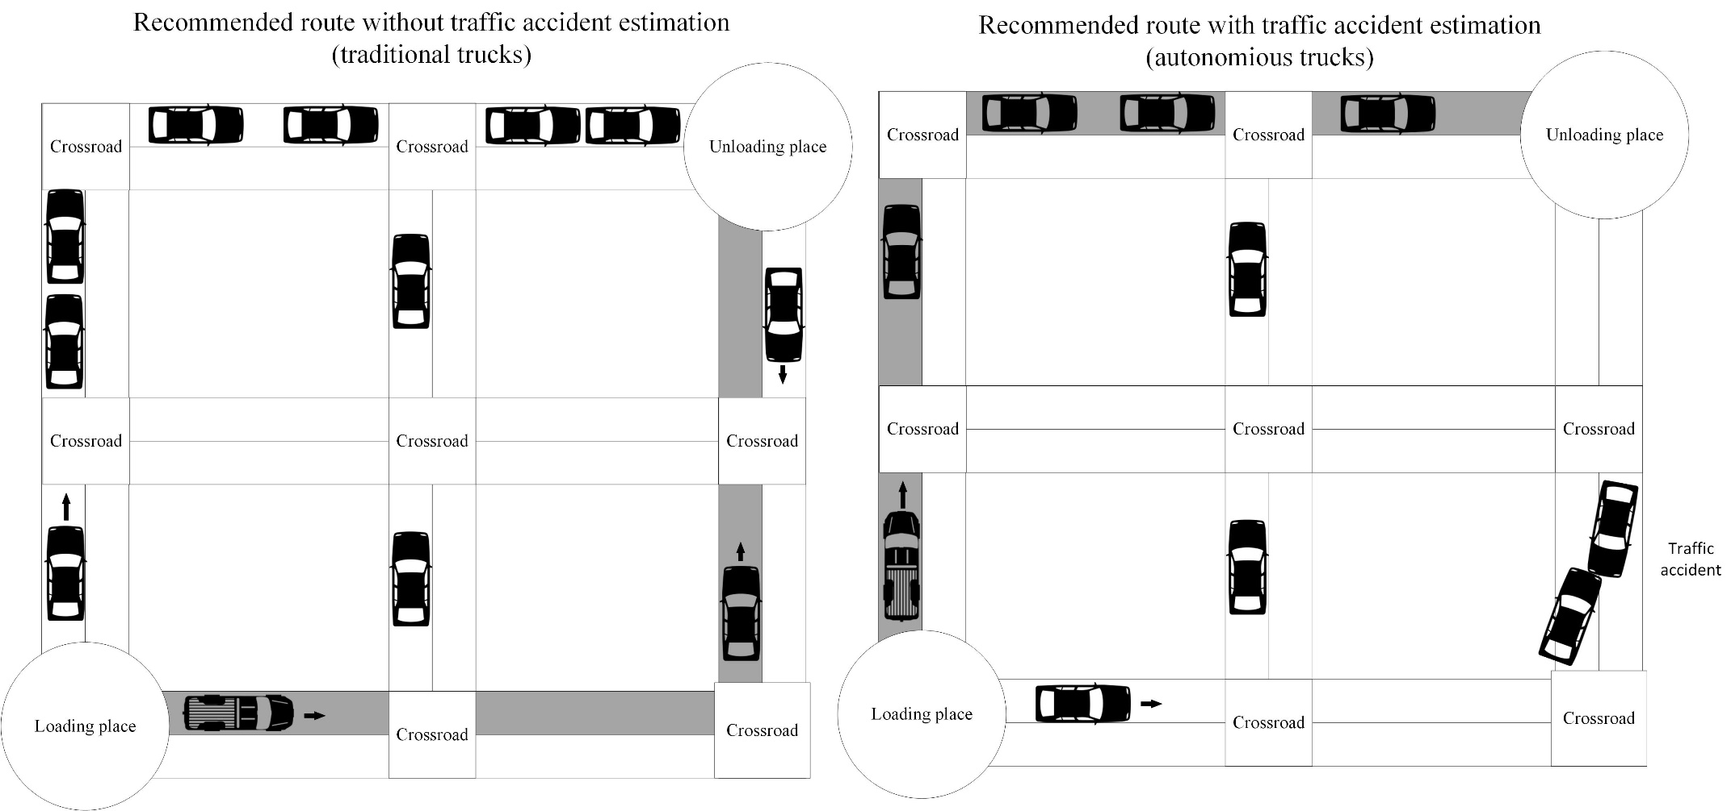
Example of route scheduling approaches

Slide 32
Route scheduling process of autonomous truck

Slide 33
Reinforcement learning
New goal function: actual food quality
States:
Sequence of operations
Delivery status
Food quality
Actual food quality evaluation based on Naive Bayes
Delivered time | Time window end | Order status
29340 | 6660 | Delivered
30060 | 5940 | Delivered
36000 | 7200 | Delivered
36822 | 2778 | Delivered
37572 | 2028 | Delivered
50400 | 7200 | Delivered
54000 | 7200 | Delivered
54408 | 3192 | Delivered
64008 | 792 | Not delivered
64212 | 588 | Not delivered
64422 | 378 | Not delivered

Slide 34
Reinforcement learning example

Slide 35
Truck ID | Order ID | Stop ID | pxcor | pycor | delivery status | schedule ID | Stop type | Order situation
281 | 0 | 1 | 64 | 29 | passed | 21 | road
282 | 0 | 8 | 62 | 21 | passed | 21 | road | fulfillment center to load
281 | 0 | 10 | 62 | 22 | passed | 21 | road
281 | 0 | 11 | 62 | 21 | passed | 21 | road | fulfillment center to load
281 | 0 | 42 | 36 | 17 | passed | 21 | road
281 | 92442 | 43 | 36 | 16 | passed | 21 | road | Delivered
282 | 0 | 68 | 6 | 18 | passed | 21 | road
281 | 92409 | 68 | 22 | 6 | passed | 21 | road | Delivered
282 | 92488 | 78 | 2 | 12 | passed | 21 | road | Delivered
281 | 0 | 47 | 36 | 13 | passed | 21 | road
281 | 92413 | 126 | 6 | 9 | none | 21 | Household unload
281 | 0 | 128 | 6 | 10 | none | 21 | road
282 | 0 | 858 | 62 | 21 | none | 21 | fulfillment center to unload
282 | 0 | 860 | 63 | 21 | none | 21 | road
282 | 0 | 866 | 64 | 16 | none | 21 | final stop
281 | 92472 | 87 | 34 | 12 | passed | 21 | road | Delivered
281 | 92494 | 95 | 30 | 15 | passed | 21 | road | Delivered
282 | 92416 | 99 | 10 | 24 | passed | 21 | road | Delivered
282 | 0 | 107 | 12 | 19 | passed | 21 | road
281 | 0 | 119 | 10 | 12 | passed | 21 | road

Slide 36
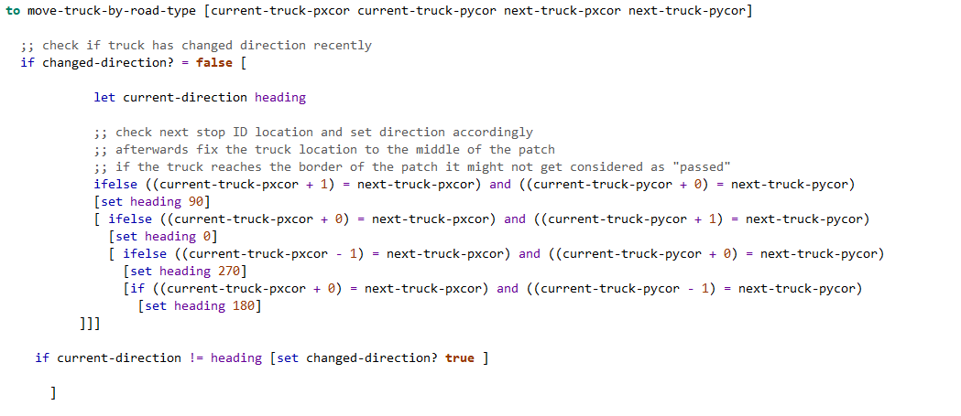
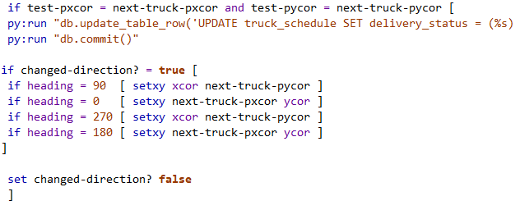
Truck movement

Slide 37
MODEL OUTPUT ANALYSIS

Slide 38
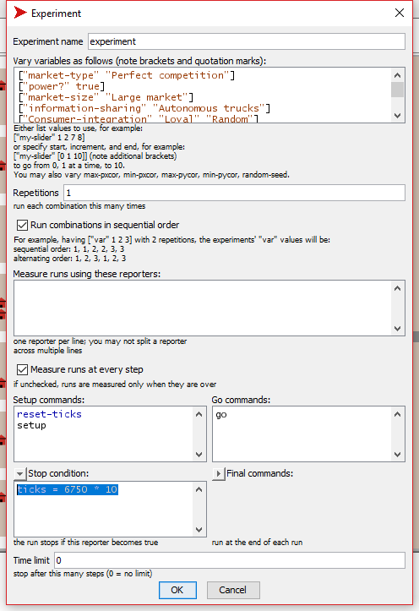
BehaviorSpace (Netlogo)
BehaviorSpace runs a model many times, systematically varying the model’s settings and recording the results of each model run. This process is sometimes called “parameter sweeping”. It lets you explore the model’s “space” of possible behaviors and determine which combinations of settings cause the behaviors of interest.

Slide 39
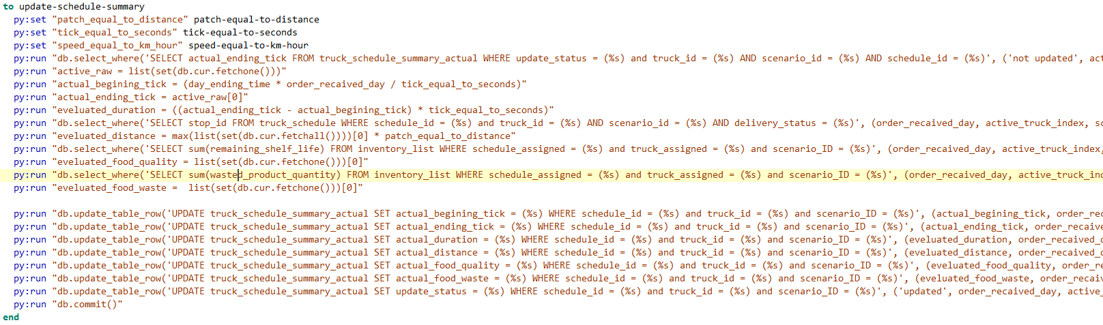
Save model output

Slide 40
FINAL NOTES

Slide 41
Tips
Input data methods:
Real data
Neural network
Distribution fitting
Create a flow chart of data, process and database
Prepare testing scenarios
Understand the software – patch and coordinate system
Difficulties when combining multiple programming languages (debugging)
Computation time (currently 4 hours per day i7-4710HQ, 2.5 GHz, 8 CPUs).

Slide 42
Useful resources
Netlogo extensions (e.g. Python): https://github.com/NetLogo/NetLogo/wiki/Extensions
Netlogo library: https://ccl.northwestern.edu/netlogo/models/
Introduction to Agent Based modeling: www.complexityexplorer.org
Python agent based model framework: Mesa
Agent-based modeling software overview: Abar, S., Theodoropoulos, G. K., Lemarinier, P., & O’Hare, G. M. (2017). Agent Based Modelling and Simulation tools: A review of the state-of-art software. Computer Science Review, 24, 13-33.

